Slide 1
Object Oriented Programming
Objects, Inheritance, Encapsulation
Java
FRC Java
ArmSystem Part 1 – Basic Movement
Notes:
Have browser with references open
Preferably with robot on
Provide background on the first two years of Java and issues

Slide 2
Bigger Object 27
Object 1
Parameter 1
Parameter 2
Function A
Function B
Function 27.A
Function 27.B
Function 27.C
Function 27.D
Function 27.E
Function 27.F
Object 2
Parameter 1
Function C
Object 3A
Parameter 1
Object 3
Function D
Notes:
Starts with bottom level objects
Objects are basic unit
Parameters are inputs to help define an object or for a method to use in performing its function
Functions are processes (jave methods) for the class/object
Object 3A extends object3 – can be a specific instatiation or can add extension (new methods)
A class is a blueprint or generic object with standard functions defined as methods
An object is an instance of the class (blueprint)
Create an object by “instantiating” a class.
Multiple objects can be combined to make an object with a broader definition
Encapsulation – keep the inner workings of the class hidden.
expose methods
Example – big system designer specs a subsystem and puts out for bid. They spec the functionality, not how it works internally.
In FRC the best examples are speed controllers
We can do it to – allow build to come up with multiple hardware solutions as long as the functions are covered (public methods are the same)
For a test-bed, this can include “null” functions where the subsystem isn’t physically available.

Slide 3
Talon
Port
Inverted
Speed Controller
set(double)
setInverted(Boolean)
Digital Input (Limit Switch)
Port
get()
Notes:
Speed Controller is an INTERFACE standard to all specific (make and model) motor controllers
Port is a required input so our code has the address of the controller
PWM –wired port
CAN – defined internally via web console
Set is a common method to send a “speed” value between -1 and 1 (zero is off) to the controller
The controller uses the speed range to send bus voltage (-12 to +12) to the motor
Digital Input can be any on/off one/zero input. Limit switches (a spring loaded switch that has to be held to activate) are a common use.
Be aware there are NO and NC switches, and “open” is considered “true” by RoboRIO circuitry
Sensors can be digital (0/1) or analog (0-1023 on RoboRIO)

Slide 4
Linear Actuator
Talon Speed Controller
move(speed)
moveUp()
moveDown()
isTop()
isBottom()
Top Limit Switch
Bottom Limit Switch
Notes:
This specific implementation
Theoretical – not the actual code – but a possible exercise
Would be very appropriate if there were two actuators for the arm
Functions – methods
encapsulation of the requirements of this implementation are buried inside the class
motor direction
NO vs NC switches
Direction of the motor at the time it hits a limit switch
This OO convention allows easier changes to a class, or different classes
e.g. a designer can specify standard methods (functions) in a request for bids
each bidder can build their internals for an object very differently, as long as the external functions produce the required result

Slide 5
FRC “Main”
Robot
OI
Subsystems
Initialization
set things up
Autonomous
schedule commands
TeleOp
schedule commands
RobotMap
ArmSystem
Commands
Joystick Arm
etc
Notes:
WARNING
The logical structure of the ArmSystem project
The java “project has several “packages” or groupings of code members
these are physically paths/folders in the workspace
each “class” shown in Eclipse is a file
a physical class can contain multiple class definitions – this can be an extensive subject on its own out of scope right now
OI, RobotMap, and Robot are grouped in the same package for FRC convention
Commands are in another package
seen from another team was adding packages to group commands by the subsystem they work with (e.g. all Arm together, all Drive together, etc.)
Subsystems are in a package
Classes are the distinct blueprints for each object
RobotBuilder as a tool is something we’ve used the last two seasons to kick-start code
The wpilib extensions to Eclipse provide templates under the “new” for commands, command groups, subsystems, etc. for specific FRC class types
Code generators have their limits, and RobotBuilder does create confusion for a java novice by using the same names for objects and classes – not necessary a bad thing unless the class is generic

Slide 6
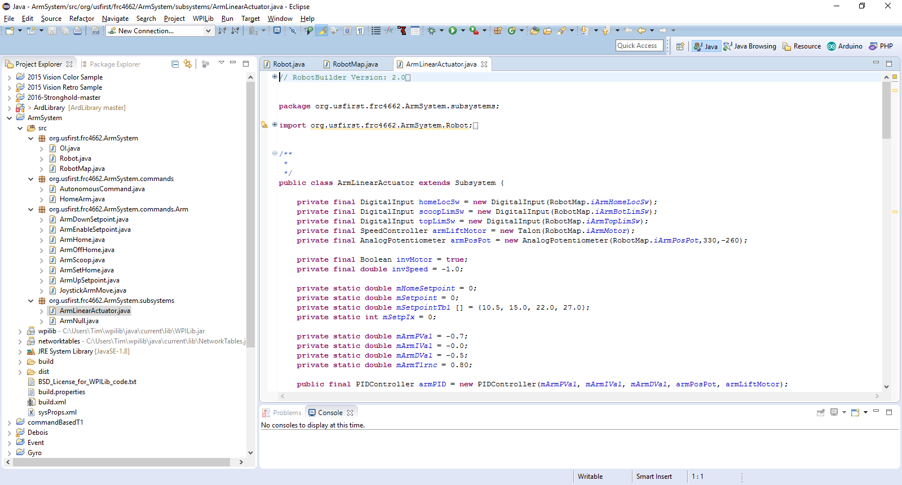
Eclipse IDE
Integrated Development Environment
Open Source eclipse.org
Add-ons for many languages
Real-time syntax and reference validation
WPIlib extensions for FRC authorized objects
3rd party support for optional add-ons
e.g. Original Equipment Manufacturers may provide Java/C++ code for their products as either samples or libraries
https://eclipse.org/home
Notes:
Don’t get hung up in the exact layout. Screen shots are from installs with additional tools.
There are some new wrinkles in this sample that we’ll get into when looking at the code
NOTE that the names shown at the detail level in this shot are class names, the physical files may actually contain multiple classes.
Be aware of the logical code structure, not just where each piece is stored.
Also note that the wpilib source is all available here and can be looked at. Some teams have programmers that have “enhanced” the wpi code.

Slide 7
public class OI {
public Joystick joystick1;
public OI() {
joystick1 = new Joystick(0);
}
}
OI – Operator Interface
A standard class in the command based structure that defines the driver’s station objects (joystick, gamepad, buttons) and relationship to commands
The port and button numbers relate to the USB port assignment through the Driver’s Station software, and the button numbers on each model joystick/gamepad.

Slide 8
/**
* The RobotMap is a mapping from the ports sensors and actuators are wired into
* to a variable name. This provides flexibility changing wiring, makes checking
* the wiring easier and significantly reduces the number of magic numbers
* floating around.
*/
public class RobotMap {
public static int iArmHomeLocSw = 2;
public static int iArmBotLimSw = 1;
public static int iArmTopLimSw = 0;
public static int iArmPosPot = 1;
public static int iArmMotor = 0;
public static void init() {
}
}
This version of RobotMap is used to define the port numbers for each object.
This information needs to be documented and communicated with the Electrical Team. It is the map for where things plug in to the RoboRIO.
Missing here are comments on what TYPES of ports each needs. E.g. iArmPosPot is for Analog.

Slide 9
This is a Subsystem Class – it defines the Arm elevation mechanism on the test robot and all the functions or processes that can be done to move the Arm.
Listed here are the definitions for the component objects, along with a Boolean that tells us “logically” what direction the motor has to spin to move the arm Up or Down, relative to the speed from a Joystick (which IMHO is backwards!)
public class ArmLinearActuator extends Subsystem {
private final DigitalInput homeLocSw = new DigitalInput(RobotMap.iArmHomeLocSw);
private final DigitalInput scoopLimSw = new DigitalInput(RobotMap.iArmBotLimSw);
private final DigitalInput topLimSw = new DigitalInput(RobotMap.iArmTopLimSw);
private final SpeedController armLiftMotor = new Talon(RobotMap.iArmMotor);
private final Boolean invMotor = true;
Lots more stuff
Notes:
Have eclipse open to the project.

Slide 10
public class ArmLinearActuator extends Subsystem {
Cont.
public void ArmLinearActuator() {
if (invMotor) {
armLiftMotor.setInverted(invMotor);
}
}
public void initDefaultCommand() {
setDefaultCommand(new JoystickArmMove());
}
Housekeeping code
Method ArmLinearActuator is a “constructor” method that gets invoked when the class is instantiated. More later…
initDefaultCommand names the default command (if any) for the subsystem. In this example, it’s JoystickArmMove.
The default command will be in effect when no other command is active.

Slide 11
Limit Switches for the Top and Bottom of the LinearActuator. These are DigitalInput objects, so the most common thing we need to do is “get” the Boolean value telling us if the switch is open (true) or closed (false).
There needs to be communication again between Programming and Electrical/Mechanical about the type of switch being used.
Normally Open read true unless held in.
Normally Closed read false unless held in.
Normally Open were used here, so the ! (not) inverts the Boolean to provide the logically correct true/false return.
public class ArmLinearActuator extends Subsystem {
Cont.
public boolean isTop() {
return !topLimSw.get();
}
public boolean isBottom() {
return !scoopLimSw.get();
}

Slide 12
public void moveArm(double speed) {
if (isTop() == true) {
if((invMotor == true & speed < 0) || (invMotor == false & speed > 0)) {
speed = 0;
}
} else {
if (isBottom() == true) {
if((invMotor == true & speed > 0) || (invMotor == false & speed < 0)) {
speed = 0;
}
}
}
armLiftMotor.set(speed);
logArm();
}
moveArm method is given a “speed” value of type double.
It checks the top and bottom limit switchs along with the direction of travel and sets the speed to zero if motion needs to be stopped.
The validated speed is passed to the armLiftMotor.set method to drive the speed controller.
logArm sends telemetry to the dashboard.

Slide 13
public class JoystickArmMove extends Command {
public JoystickArmMove() {
requires(Robot.armSubSys);
}
// Called just before this Command runs the first time
protected void initialize() {
}
// Called repeatedly when this Command is scheduled to run
protected void execute() {
Robot.armSubSys.moveArm(Robot.oi.joystick1.getY());
}
// Make this return true when this Command no longer needs to run execute()
protected boolean isFinished() {
return false;
}
// Called once after isFinished returns true
protected void end() {
Robot.armSubSys.stopArm();
}
// Called when another command which requires one or more of the same
// subsystems is scheduled to run
protected void interrupted() {
end();
}
}
JoystickArmMove command
Housekeeping code
requires – only one command at a time may use a subsystem.
This command passes the joystick Y axis (forward/backward) directly through to the subsystem moveArm method. NOTE that the object name is used, not the class name
The methods shown are standard for all commands, and we’ll dig more into what they’re used for in later examples.

Slide 14
Java Basic
Tutorial
http://docs.oracle.com/javase/tutorial/
http://docs.oracle.com/javase/tutorial/java/concepts/index.html
Java Doc
http://docs.oracle.com/javase/8/docs/api/index.html
FRC Java
https://wpilib.screenstepslive.com/s/4485/m/13809
WPILib
http://first.wpi.edu/FRC/roborio/release/docs/java/

